Slide 1
Field Robotics
Athanasios Athanason, Jon Hager

Slide 2
Overview
Field Robotics - Anything outdoors!
Scope:
Construction
Agriculture

Slide 3
Robotics in Construction
Research in construction robotics and automation started with the Japanese in the 1980’s because the were faced with societal demographics that projected a huge shortfall in construction personnel.(mostly remote controlled and teleoperated robotics)
The closest thing to construction robotics the US focused on were RC or teleoperated systems for hazardous work such as rapid runway repair and unexploded ordnance removal.
The EU focused on developing large sized masonry for residential and construction.

Slide 4
Robotics in Construction
Robotics in Manufacturing has come a long way, why isn’t it a similar case for construction?
Production activity happens in the field “in open air, on natural terrain, and often with naturally occurring materials.”
Building and construction products are large in scale and unique in form.
Environment or field setting is typically unique

Slide 5
Causes of Lag in Construction Robotics
The industry is fragmented (Data from 2003)
48.25% of workers were employed by firms of four members or fewer
“60% of all construction workers worked for specialty trade contractors(STC) who accounted for roughly 60% of construction firm.”(STC are usually subcontractors on a project and are not responsible for the overall project)
There is an aversion to the risks associated with the introduction of new technologies.
Construction sites are “unstructured, cluttered, congested... and human workers are also present in large numbers on a construction project, making safety a paramount concern.

Slide 6
Causes of Lag in Construction Robotics cont...
There is an aversion to the risks associated with the introduction of new technologies.
“The work on a site is often conducted by subcontractors who are often reluctant or financially unable to use advance technologies which have not been entirely adopted by industry”
The goal is to meet the owners requirements by the most “efficient and least risky methods possible.”
Workers resist the idea for potential job losses.

Slide 7
Motivations
In the USA consturction as of 2002 was approximately 8% of the national GDP
5.7% in the European Union and employed over 11 million workers
Worldwide construction industry spending is about 11% of the worlds GDP
Owners have the power to require the use of specific technologies, this puts part of the risk of new technology use onto the owner, making it more feasible for companies to risk using them.

Slide 8
The Differing Niches
USA |  | EU
Residential | 47% | Residential | 26%
Commercial | 26% | Nonresidential | 31%
Civil | 17% | Civil | 20%
Industrial | 4% | Renovation/ Maintenance | 23%

Slide 9
The Differing Niches Cont...
Construction projects generally go through phases, roughly planning, design, construction, and operation phases:
Need for a project arises and requirements are identified
Developing alternative project plans that meet identified needs and evaluating economic feasibility of each.
Developing designs and specs,
Construction of facility from breaking ground to inspection.
Facility is occupied and operates Presite Automation
Shut down and dismantling.

Slide 10
Fitting Robotics in the Phases
Automation of processes can occur in all six phases of a construction project but we will focus on the final three because we are interested in physical automation ( Robotics).
PHASE 3: As research progressed large japanese construction companies began to use “on-site factories for high rise construction.”
Provides:
Just-in-time delivery of components.
Automated part tracking and materials handling
Robotic connection and assembly of parts
Centralized control in enclosed environment
Better work environment (weather invariant)
Reduced project completion time
Improved productivity and quality Onsite Factory info

Slide 11
Examples of Construction Robots
Concrete Placement and Finishing Robot
SAM Brick laying Robot
FrontRunner Autonomous Hauling
Autonomous Ripping Dozer

Slide 12
Maintenance Robotics
Sewer inspection Robot
Spider Mite

Slide 13
Decommissioning Robotics
Kaputt.r
Avant Robots Teleoperated
Robotic Snake for collapsed buildings

Slide 14
Robotics in Agriculture
Forestry
Broad Acre / Horticulture
Livestock farming

Slide 15
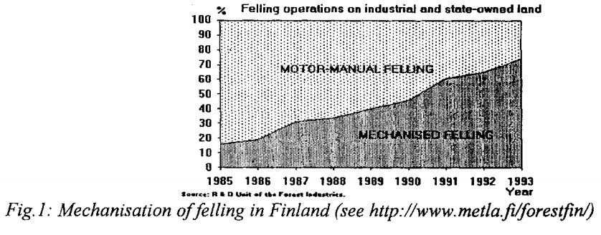
History of Forestry Robotics
Mechanization
New Zealand, 1960’s
Nordic countries, 1980’s
Human controlled, diesel, hydraulics
Notes:
NZ -
Nords - from ~20% to ~95%
CAN-controllers

Slide 16
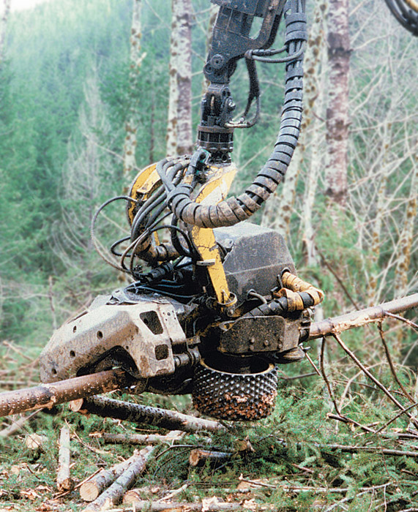
Skogsjan Cut-To-Length (CTL) Harvester

Slide 17
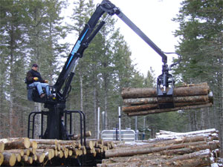
Serco 7000 Series Loader

Slide 18
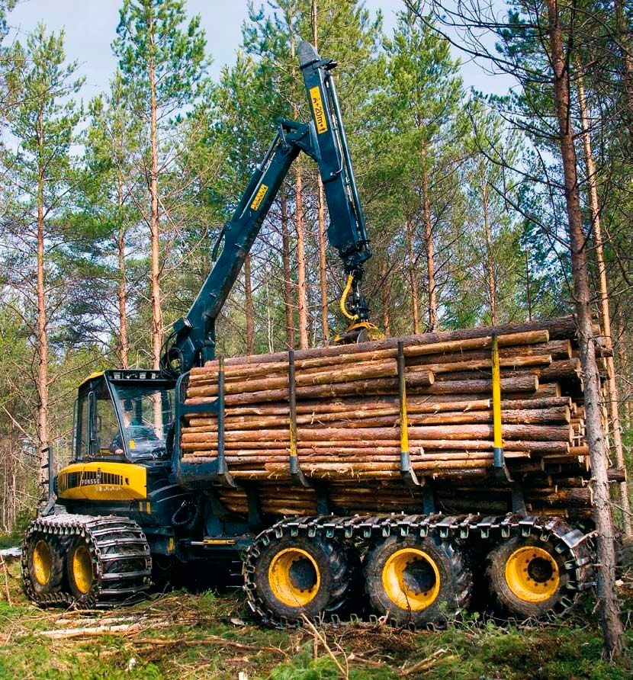
10w PONSSE OYJ Forestry Forwarder

Slide 19
Forestry - Potential Applications
Planting
Establishment
Silviculture
Forest management
Harvesting
Log making and loading

Slide 20
Forestry - Automation Challenges
Terrain
Safety
Economics
Notes:
Terrain - steep slopes
- dynamic environment
- large, heavy machinery
- damage ground infrastructure

Slide 21
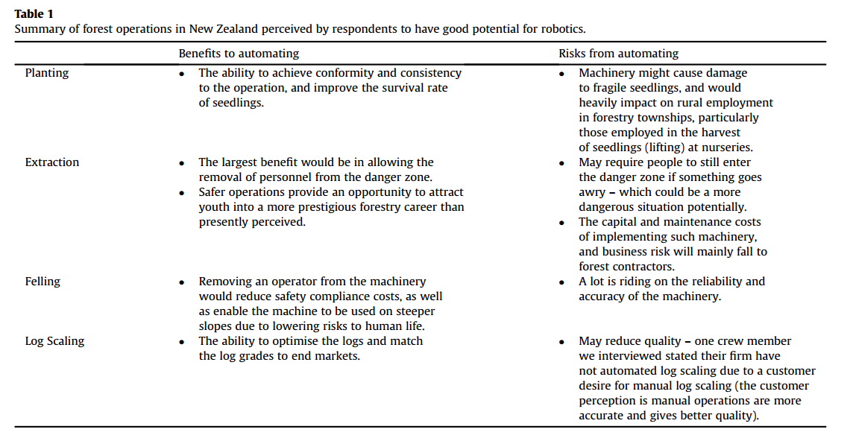
Forestry - Automation

Slide 22
Forestry - Potential Implementations
Multi-robot systems for efficiency
Focus on labor intensive jobs
Simplify the environment
Walking locomotion

Slide 23
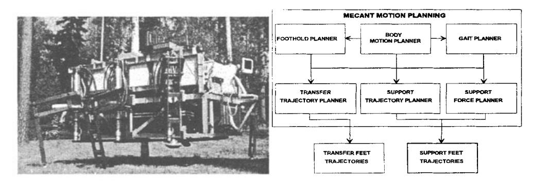
MECANT
Helsinki University of Automation (TKK)
Notes:
Helsinki University
Remote controlled
Gait planner, free gate as opposed to wave gait or adaptive gait

Slide 24
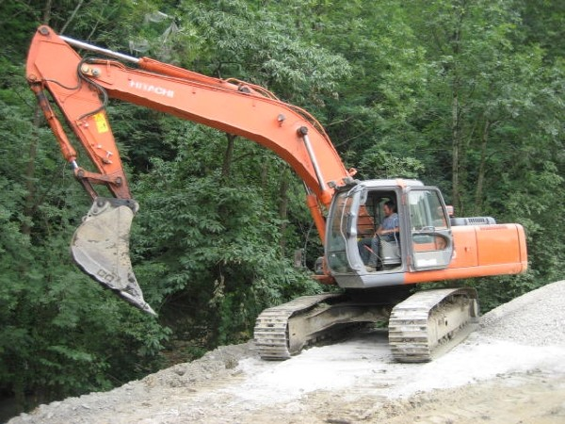
Hitachi ZX 280

Slide 25
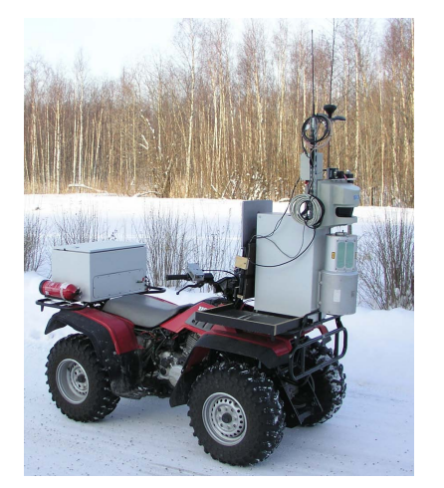
Perception and Localization
Forestix Project (TKK, 2008)
Lidar, camera, GPS, IMU
Feature-based SLAM
ATV Test Platform

Slide 26
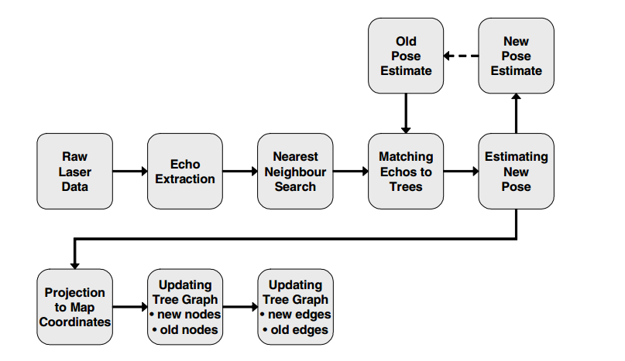
Feature Based SLAM

Slide 27
Machine Vision
Challenges
Seasonal variation
Weather
Shadows
Terrain
Poorly maintained forests

Slide 28
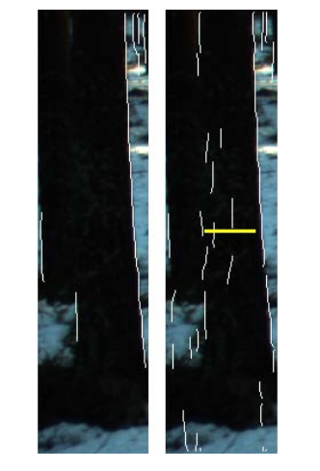
Machine Vision
Vertical Edge Detection
Homomorphic filtering
Fourier filtering
Canny or phase congruency edge detection
Canny (Left), phase congruency (Right)

Slide 29
Autonomy for Loading and Forwarding
Autonomous robotic grasping
Autonomous driving (fleet management)

Slide 30
Robotics in Plant Farming
Broad Acre Applications
Sowing
Weeding
Spraying
Harvesting

Slide 31
Broad Acre Considerations
GPS and IMU’s used during furrowing
Machine vision / furrow follower used after seedlings sprout
Stem feelers used during harvesting
Alternative: Center-pivot irrigation

Slide 32
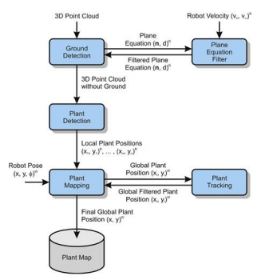
Field Navigation
Weiss and Biber
MEMS LIDAR
Could be extended to SLAM

Slide 33
Field Navigation
Rovira-Más et al.
Stereo vision
GPS
Gyroscope

Slide 34
Field Navigation
Orviz and Olivares
Single camera
Infrared sensors
Compass

Slide 35
Robotics in Plant Farming
Horticulture
Tree shakers
Hand-pickers with autonomous delivery
Bristle rollers

Slide 36
Horticulture Considerations
Localization of harvesters
Plant evaluation (ripeness)
Color detection (tomatoes, nuts)
Texture evaluation

Slide 37
Horticulture Implementations
Nielsen et al., stereo vision for thinning peach trees
Irie et al., LIDAR and camera to locate asparagus
Xiao-lin et al., stereo vision for tomato identification

Slide 38
Robotics in Animal Farming
Robot Milking
Cow identification
Traffic
Immobilization
Utter inspection/preparation

Slide 39
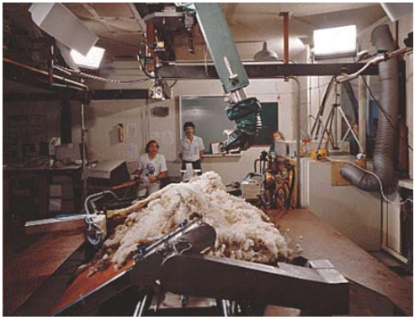
Robotics in Animal Farming
Sheep shearing
Shear Magic - University of Western Australia
Merino Wool Harvesting
SLAMP
Economic challenges

Slide 40
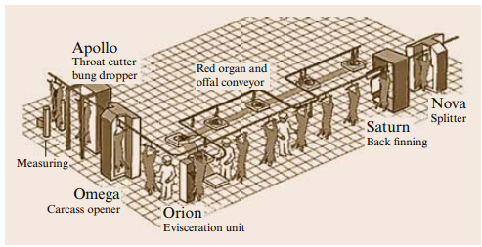
Robotics in Animal Farming
Slaughtering / butchering
Ethics
Cost
“Islands” of automation
Pig butcher line by SFK Meat Systems

Slide 41
References
Bayne, K. M., & Parker, R. J. (2012). The introduction of robotics for New Zealand forestry operations: Forest sector employee perceptions and implications. Technology in Society, 34(2), 138-148.
Billingsley, J., & Dunn, M. (2008). Robotics in agriculture and forestry. In Springer handbook of robotics (pp. 1065-1077). Springer Berlin Heidelberg.
Halme, A., & Vainio, M. (1998). Forestry robotics-why, what and when. In Autonomous robotic systems (pp. 149-162). Springer London.
Klomp, C., Jongkind, W., Honderd, G., Dessing, J., & Paliwoda, R. (1990). Development of an autonomous cow-milking robot control system. Control Systems Magazine, IEEE, 10(6), 11-19.
Lytle, A. M. (2008). Robotics in construction. In Springer handbook of robotics(pp. 1079-1099). Springer Berlin Heidelberg.
Öhman, M., Miettinen, M., Kannas, K., Jutila, J., Visala, A., & Forsman, P. (2008, January). Tree measurement and simultaneous localization and mapping system for forest harvesters. In Field and Service Robotics (pp. 369-378). Springer Berlin Heidelberg.
Segerblad, E., & Delight, B. Machine Vision in Agricultural Robotics–A short overview.

